Slide 1

CS1951 L
Blockchains & Cryptocurrencies
Fall 2025
Lecture 22
DeFi
Maurice Herlihy
Brown University

Slide 2

Decentralized Finance (DeFi)
Higher-Level Financial Protocols
Built on Blockchain
Smart Contracts
“programmable money”

Slide 3
Decentralized Finance (DeFi)
Derivatives
Payment Networks
Stable Coins
Exchanges
Loans

Slide 4
Exchanges
Trade one asset for another
Want good liquidity
Meaning trades don’t have to wait
Want low slippage
Meaning purchase shouldn’t move price

Slide 5

Centralized Exchanges
Convenient
Good Liquidity
Low Slippage
Secure, compliant, etc.
See CoinBase, BitFinex, etc.

Slide 6
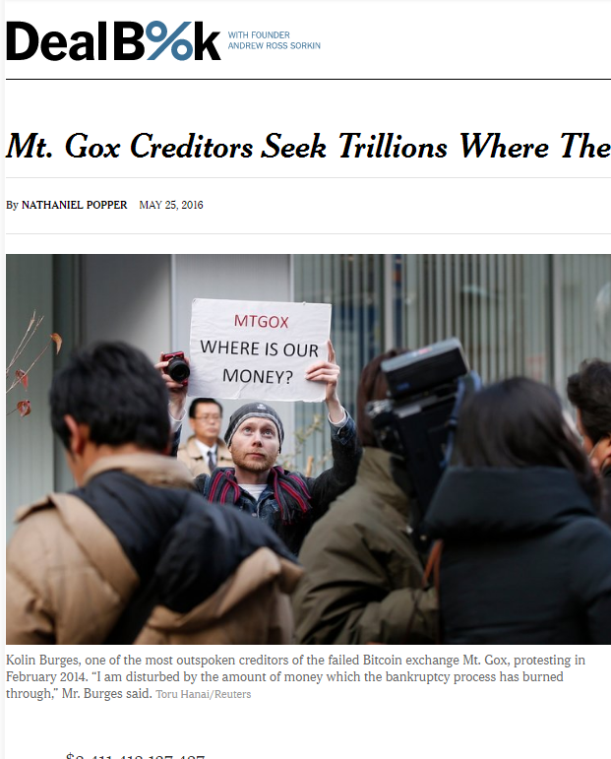
Also Centralized Exchanges
Notes:
Tabloid scandals and mysteries abound. Mt Gox, a Japanese site that acted as a bank for Bitcoin holdings seems to have “lost”, somehow, about $600 M of depositor’s money, all in Bitcoin. It has never been explained whether this money was stolen, whether the keys were simply lost, or whether something more complicated happened.

Slide 7
Order Book: Guilder vs Florin Tokens
Sell offers
Guilder Token | Price
1 | @1.21
1 | @1.23
10 | @1.26

Slide 8

Order Book: Guilder vs Florin Tokens
I want 3 Guilder @ ≤1.25
Guilder Token | Price
1 | @1.21
1 | @1.23
10 | @1.26

Slide 9
Order Book: Guilder vs Florin Tokens
I want 3 Guilder @ ≤1.25
Guilder Token | Price
1 | @1.21
1 | @1.23
10 | @1.26
sold
sold
Too expensive

Slide 10
Order Book: Guilder vs Florin Tokens
I want 3 Guilder @ ≤1.25
Guilder Token | Price
1 | @1.21
1 | @1.23
10 | @1.26
sold
sold
Too expensive
My slippage is price difference between first @1.21 and last @1.23,

Slide 11
Order Book: Guilder vs Florin Tokens
I want 3 Guilder @ ≤1.25
Guilder Token | Price
1 | @1.21
1 | @1.23
10 | @1.26
sold
sold
Too expensive
My slippage is the price difference between first @1.21 & last 1@1.23
My liquidity is poor because I am still waiting for 3rd purchase

Slide 12
AMMs

Slide 13



Automated Market Maker
Trade between …
2 or more liquidity pools
Using mathematical formula
No waiting, no theft, no KYC/AML …

Slide 14

Liquidity Providers
Liquidity Providers lend assets to pool
In return for shares in AMM
Earn Fees
Governance
Can add or remove liquidity

Slide 15

Constant-Product AMM
guilder
Two liquidity pools
Florin & guilder
$$x y=1$$
States lie on curve
florin

Slide 16

Constant-Product AMM
guilder
$$y= \frac{1}{x}$$
florin

Slide 17
Constant-Product AMM
guilder
½ florin
(½,2)
2 guilder
$$y= \frac{1}{x}$$
2
State lies on curve
½
florin

Slide 18
Trader converts 1 florin to guilder
guilder
(½,2)
1 florin in
3/2
florin

Slide 19
Trader converts 1 florin to guilder
guilder
(½,2)
1 florin in
4/3 guilder out
(3/2,2/3)
3/2
florin

Slide 20
Fees
Each trade incurs fees
Usually added to liquidity pool
Eventually returned to LPs
0.3% for Uniswap
Ignoring for now

Slide 21
Arbitrage
guilder
AMM state
Actual market state
florin

Slide 22
Arbitrageur profits by correcting exchange rate
guilder
Risk-free profit
florin

Slide 23
Arbitrage
AMM can’t read market rates
But arbitrageurs will ensure accuracy
AMM can act as price oracle?
Mostly yes, but open to manipulation …

Slide 24
Price
guilder
dx
dy
florin

Slide 25
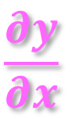
Spot price is (negative of) derivative
guilder
$$\frac{∂y}{∂x}$$
florin

Slide 26
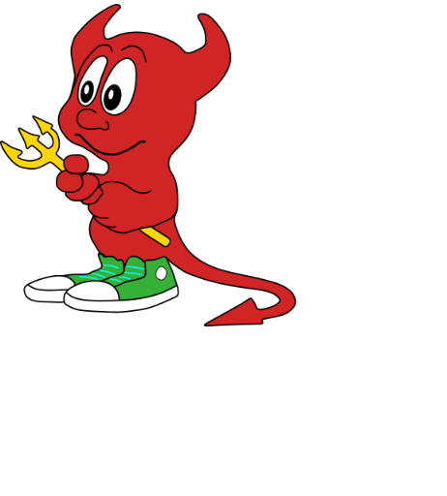
Put 1 Florin!
Front-Running
guilder
Should return 1.3333 guilders
(½,2)
florin

Slide 27
Put 1 Florin!
Front-Running
guilder
Delayed!
Should return 1.3333 guilders
(½,2)
florin

Slide 28
Front-Running
Put 10 Florins!
guilder
Should return 1.3333 guilders
Front run!
(½,2)
florin

Slide 29
Front-Running
guilder
Should return 1.3333 guilders
Front run!
(½,2)
Returns 1.9047 guilders
florin

Slide 30
Front-Running
guilder
Should return 1.3333 guilders
(½,2)
Returns 1.9047 guilders
florin

Slide 31
Front-Running
guilder
Should return 1.3333 guilders
(½,2)
Returns 1.9047 guilders
Got only 0.0082 guilders?
florin

Slide 32
Put 1 Florin!
Front-Running
Expecting 1.3333 guilders
Put 10 Florins!
guilder
Got 1.9047 guilders
Cashing in!
Got only 0.0082 guilders?
(½,2)
florin

Slide 33
Front-Running
guilder
Cashing in!
(½,2)
Put back my guilders!
Got 10.9979 florins
florin

Slide 34
Front-Running
I got 1.3250 fewer guilders than expected?
guilder
I got risk-free profit of 0.9979 florins!
florin

Slide 35
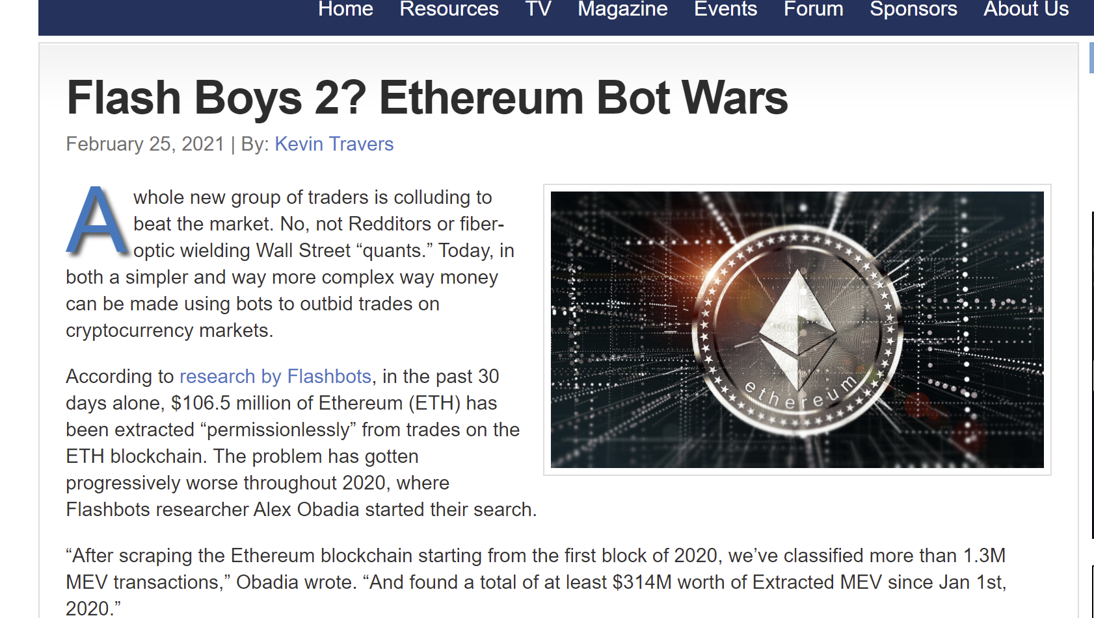
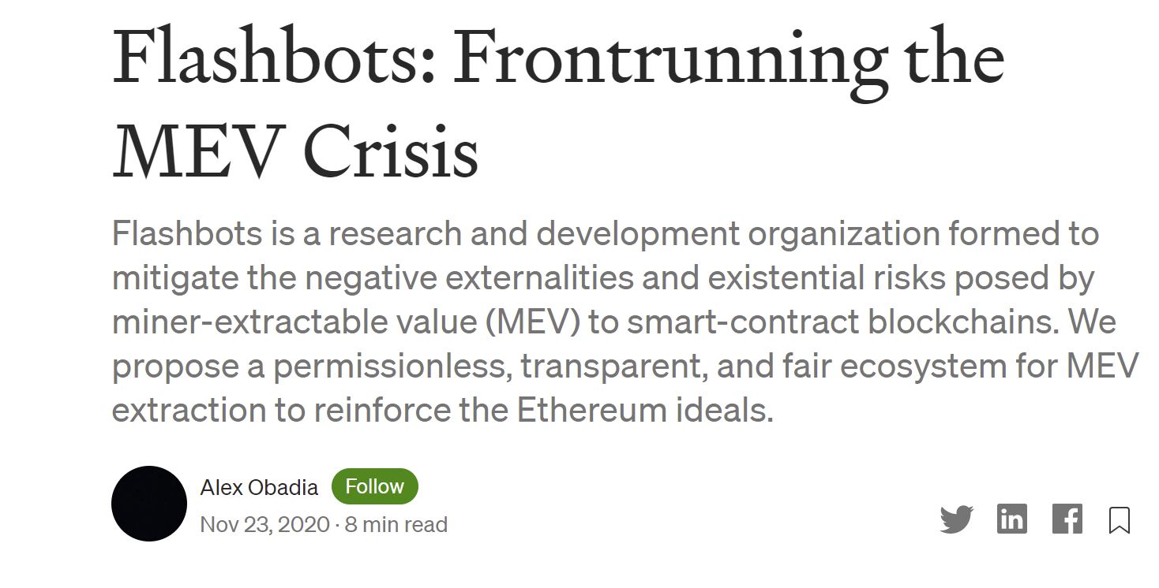
This Happens

Slide 36

$$y=f(x)$$
General AMMs
guilder
Which functions make sense?
florin

Slide 37

$$y=c x$$
Linear AMMs
guilder
Constant price
No slippage
What if price changes?
One pool emptied
florin

Slide 38
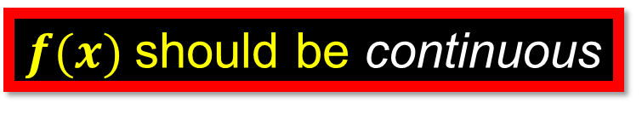
$$y=f(x)$$
General AMMs
guilder
$f(x)$should be continuous
Pool sizes don’t change abruptly
florin

Slide 39
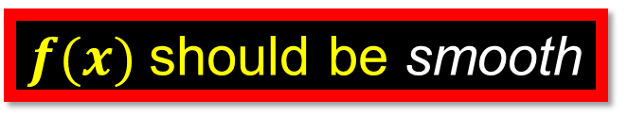
$$y=f(x)$$
General AMMs
guilder
$f(x)$should be smooth
Prices don’t change abruptly
florin

Slide 40
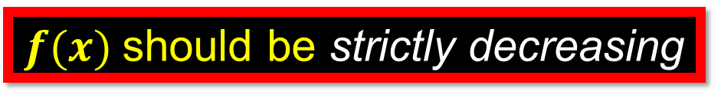
$$y=f(x)$$
General AMMs
guilder
$f(x)$should be strictly decreasing
Adding florins shouldn’t create more guilders
???
put
florin

Slide 41
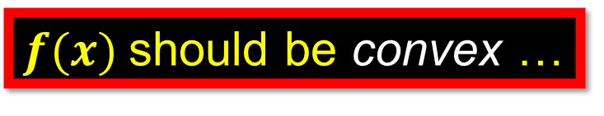
$$y=f(x)$$
General AMMs
guilder
$f(x)$should be convex …
Meaning tangent line …
Below the curve
florin

Slide 42
$$y=f(x)$$
Convexity
Market price

Slide 43
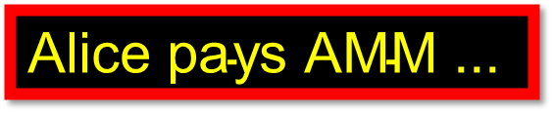
$$y=f(x)$$
Convexity
$$\text{Alice} \text{pays} \text{AMM}\text{ ...}$$
put
Market price

Slide 44

$$y=f(x)$$
Convexity
$$\text{Alice} \text{pays} \text{AMM}\text{ ...}$$
AMM tangent slope = market price
put
get
Market price

Slide 45
$$y=f(x)$$
Convexity
$$\text{Alice} \text{pays} \text{AMM}\text{ ...}$$
AMM tangent slope = market price
Large buy gets less than market price
put
get
Market price
Slippage works against Alice
get at market price

Slide 46
Non-Convexity
Market price

Slide 47
Non-Convexity
put
get

Slide 48
Non-Convexity
put
get
at market price

Slide 49
Non-Convexity
put
AMM yields better than market
get
at market price
Runaway effect!
Traders buy up undervalued assets

Slide 50
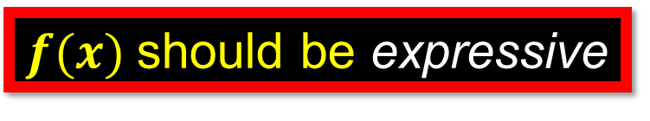

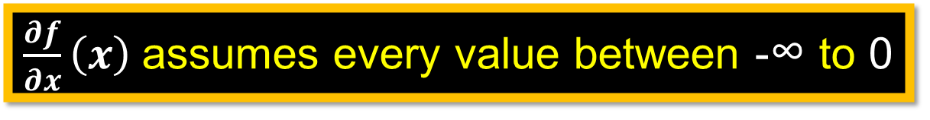
$$y=f(x)$$
General AMMs
guilder
$f(x)$should be expressive
Adapts to any market price …
$\frac{∂f}{∂x}\left(x\right)$assumes every value between -∞ to 0
No linear AMMs
florin

Slide 51


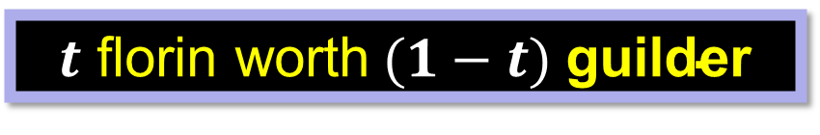
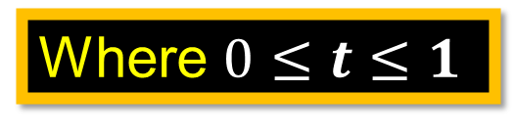
Relative value of florin vs guilder?
Valuation
$t$ florin worth$(1−t) \text{guilder}$
Where $0≤t≤1$
Every valuation is a point in unit interval
florin
guilder
$$t$$
$$1−t$$
0
1

Slide 52
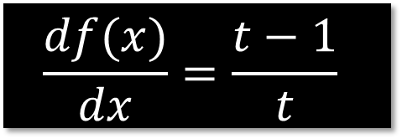
Valuation vs Price
$$\frac{df(x)}{dx}=\frac{t−1}{t}$$
florin
guilder
$$t$$
$$1−t$$
0
1

Slide 53
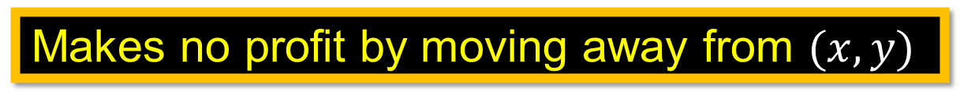
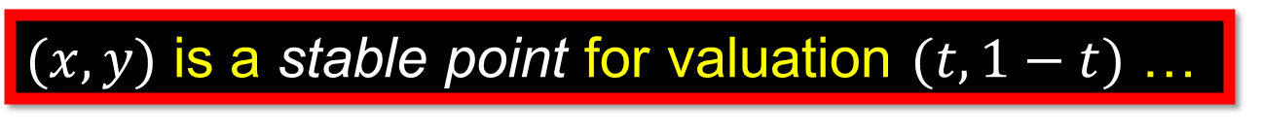
Stable Point for a valuation
$(x,y)$ is a stable point for valuation $(t,1−t)$ …
If an arbitrageur …
Makes no profit by moving away from $(x,y)$
If function satisfies our properties …
Every valuation has unique stable point

Slide 54
Sequential Composition
Given
AMM A: florins → guilders …
AMM B: guilders → francs …
Construct:
AMM C: florins → francs

Slide 55


Sequential Composition Example
guilder
$$y= \frac{p}{x}$$
$$(a,\frac{p}{a})$$
Constant-product function
florin
Initial state

Slide 56
guilder
$$y= \frac{p}{x}$$
Put florins in AMM A
$$(a,\frac{p}{a})$$
Get back guilders
florin

Slide 57

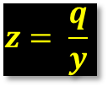
guilder
$$y= \frac{p}{x}$$
franc
$$z= \frac{q}{y}$$
$$(a,\frac{p}{a})$$
$$(b,\frac{q}{b})$$
florin
guilder
Constant-product function
Initial state

Slide 58
guilder
$$y= \frac{p}{x}$$
franc
$$z= \frac{q}{y}$$
$$(a,\frac{p}{a})$$
$$(b,\frac{q}{b})$$
florin
guilder
Put guilders in AMM B
Get back francs

Slide 59
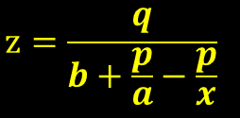
guilder
$$y= \frac{p}{x}$$
franc
$$z= \frac{q}{y}$$
$$(a,\frac{p}{a})$$
$$(b,\frac{q}{b})$$
florin
guilder
Function, but not constant-product
franc
$$z=\frac{q}{b+\frac{p}{a}−\frac{p}{x}}$$
florin

Slide 60
guilder
$$y= \frac{p}{x}$$
franc
$$z= \frac{q}{y}$$
$$(a,\frac{p}{a})$$
$$(b,\frac{q}{b})$$
florin
guilder
franc
$$z=\frac{q}{b+\frac{p}{a}−\frac{p}{x}}$$
florin

Slide 61
Parallel Composition
Given
AMM A: florins → guilders …
AMM B: florins → guilders …
Construct:
AMM C: florins → guilders

Slide 62

guilder
$$y= \frac{p}{x}$$
guilder
$$y= \frac{q}{x}$$
$$(a,\frac{p}{a})$$
$$(b,\frac{q}{b})$$
florin
florin
Different prices …
Different slippage
Let’s buy guilders with florins …
How to split between them?

Slide 63
Parallel Composition Algorithm
Buy from one with best price …
Until slippage causes other’s price to be better …
Then switch …
Repeat as needed

Slide 64
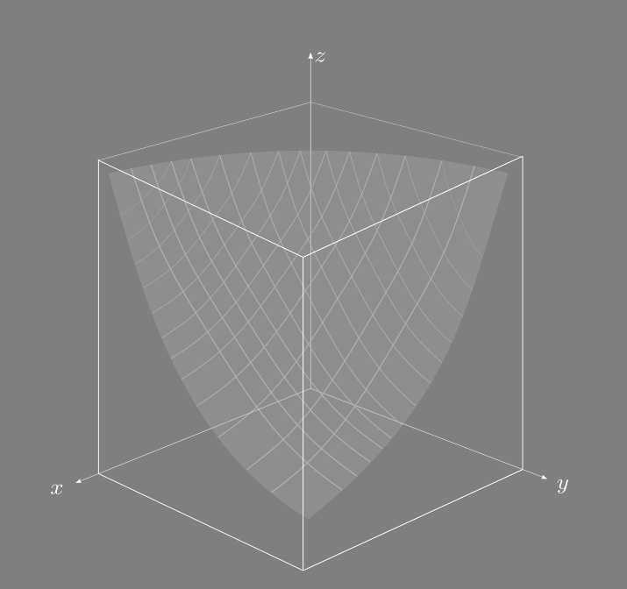
AMMs Can Manage > 2 Assets
Math is more complex ….
But most ideas generalize

Slide 65
Overcollateralized Loans

Slide 66

I think my BTC holdings will increase in value, but I need ETH right now
BTC
BTC

Slide 67

I want to borrow $1M worth of ETH for 1 year
Give me 2M worth of BTC as collateral!
ETH
Lender
BTC
BTC

Slide 68
ETH
Lender
BTC
BTC

Slide 69
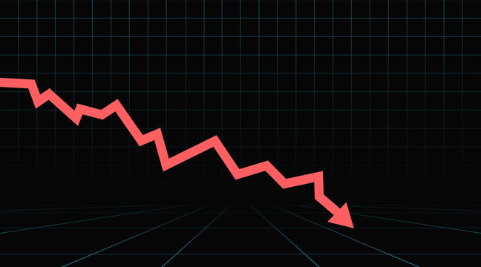
BTC price
BTC vs ETH healthy
Lender
BTC
BTC
ETH

Slide 70
BTC price
Here’s your collateral, minus interest!
Lender
BTC
BTC
ETH

Slide 71
BTC price
BTC price too low!
Liquidating collateral!
Damn!
Lender
BTC
ETH
BTC
ETH

Slide 72
Flash Loans

Slide 73
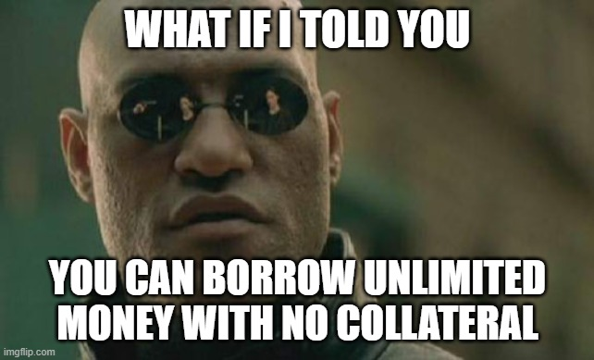

Slide 74
Flash Loans
Start Transaction
Borrow money
Go wild
Repay money with interest
Commit Transaction

Slide 75
Flash Loans
Cannot commit if money not repaid!
Start Transaction
Borrow money
Go wild
Repay money with interest
Commit Transaction

Slide 76
Flash Loans
Start Transaction
If you don’t commit, you revert, & never borrowed in first place!
Borrow money
Go wild
Repay money with interest
Commit Transaction

Slide 77





Flash Loans

Slide 78
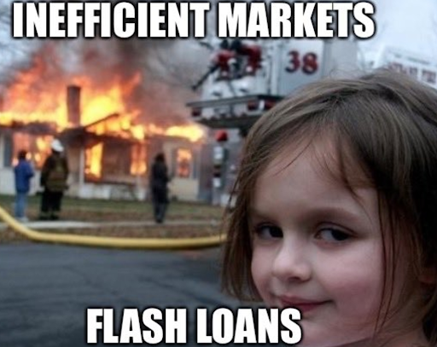

Slide 79
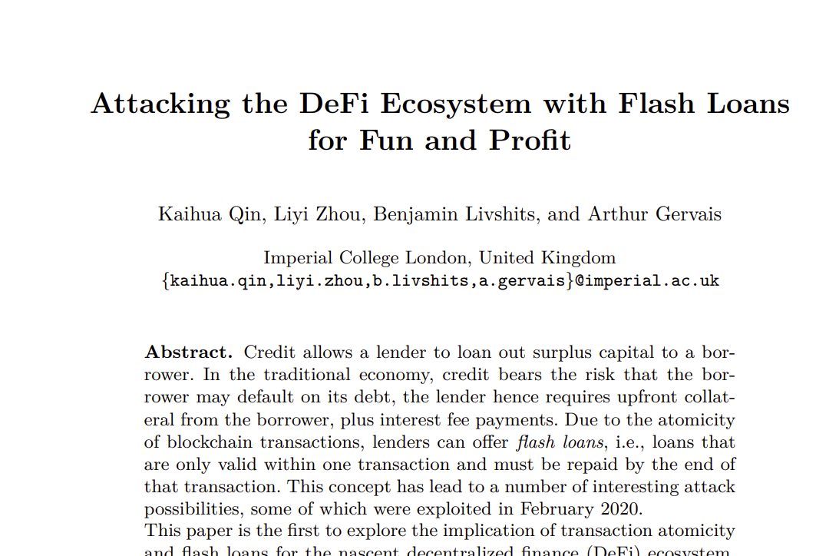

Slide 80

Price Oracles
How do exchanges know market rates?
No trusted 3rd parties
Ask other on-chain DEXs!
But DEX prices can be manipulated …

Slide 81
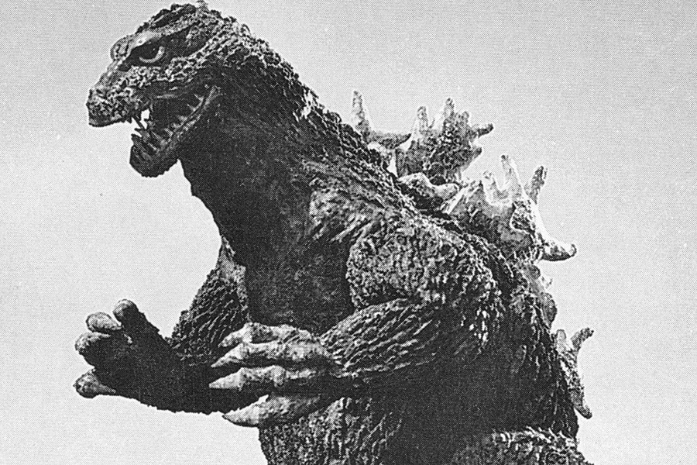
Flash Loan Attack
Borrow ETH on DEX
Convert to sUSD at victim’s Oracle AMMs
Distorting Oracles’ price information
Convert back at Victim at distorted rate
Repay loan
Keep the difference

Slide 82

1 ETH = 1 sUSD
Oracle AMMs
ETH
sUSD
Exchange

Slide 83
1 ETH = 1 sUSD
Flash lend me 1 gazillion ETH
Oracle AMMs
Exchange

Slide 84
1 ETH = 1 sUSD
Oracle AMMs
Owes 1G ETH
Exchange
ETH

Slide 85
1 ETH = 1 sUSD
Hey, Oracles, convert my 1G ETH to sUSD!
Oracle AMMs
Owes 1G ETH
Exchange
ETH

Slide 86
1 ETH = 1 sUSD
2 ETH = 1 sUSD
My purchase was so large it moved the market!
Oracle AMMs
Owes 1G ETH
sUSD
Exchange

Slide 87
1 ETH = 1 sUSD
2 ETH = 1 sUSD
Oracle AMMs
Convert my sUSD to ETH!
Owes 1G ETH
sUSD
Exchange

Slide 88
1 ETH = 1 sUSD
2 ETH = 1 sUSD
Oracle AMMs
Hey oracles, what’s the rate?
Convert my sUSD to ETH!
Owes 1G ETH
sUSD
Exchange

Slide 89
1 ETH = 1 sUSD
2 ETH = 1 sUSD
Oracle AMMs
Here you go, @market rate!
Owes 1G ETH
Exchange
ETH
ETH

Slide 90
1 ETH = 1 sUSD
2 ETH = 1 sUSD
Oracle AMMs
Owes 1G ETH
Exchange
ETH
ETH

Slide 91
1 ETH = 1 sUSD
I repay your flash loan & commit transaction,
keeping the extra ETH
2 ETH = 1 sUSD
Oracle AMMs
Uh, oh …
ETH
Exchange
ETH

Slide 92
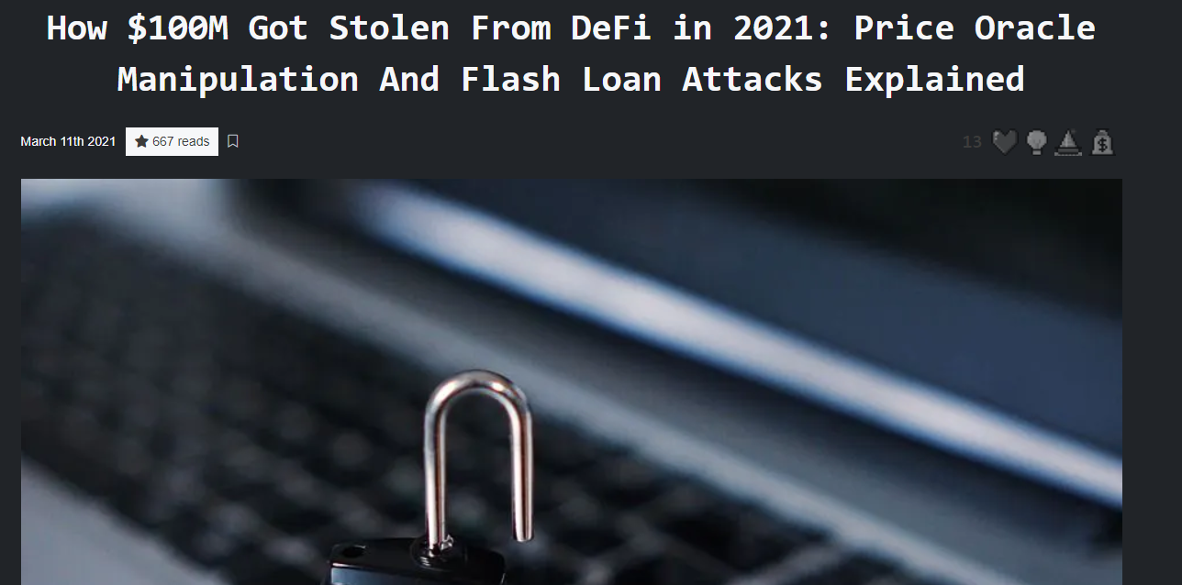
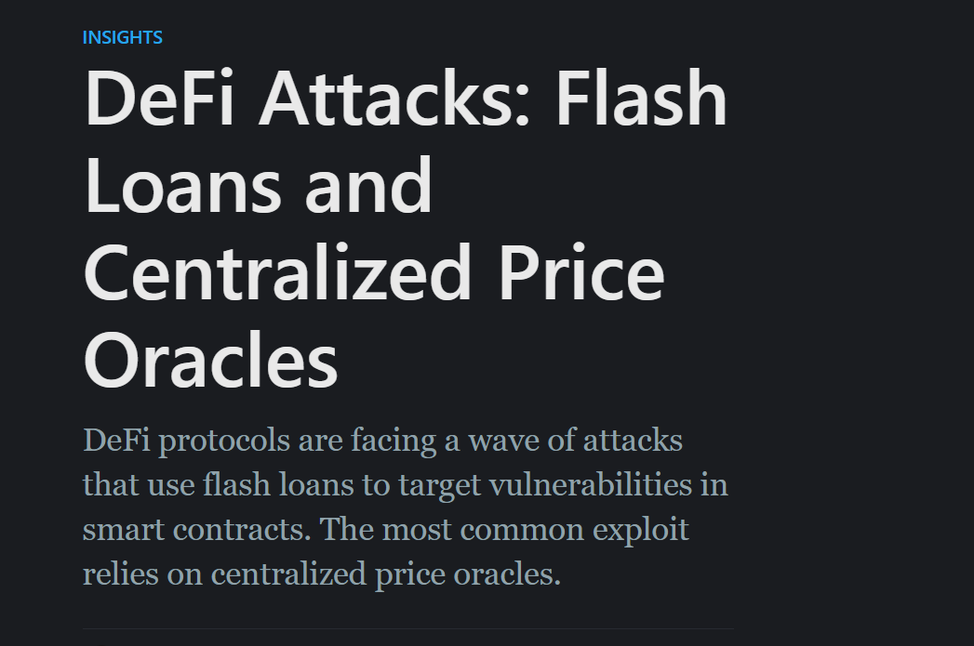
This Happened
18 February 2020
Victim was bZx exchange
Oracles were Uniswap & Kyber Reserve
Attacker’s cost: 118.79 USD fees
Attacker’s profit: 635,000 USD
Other attacks too ….

Slide 93
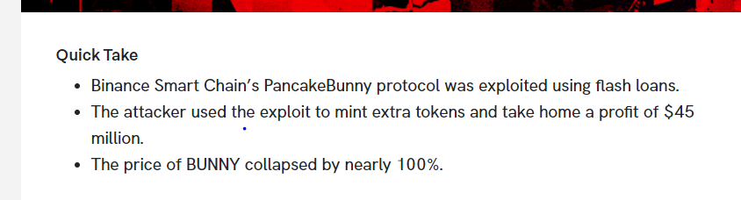
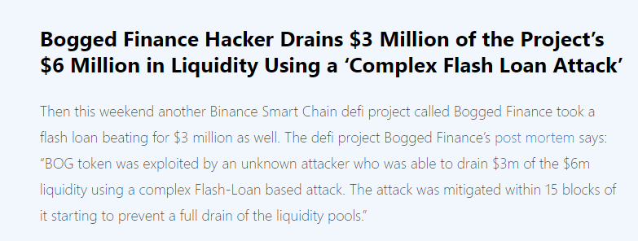
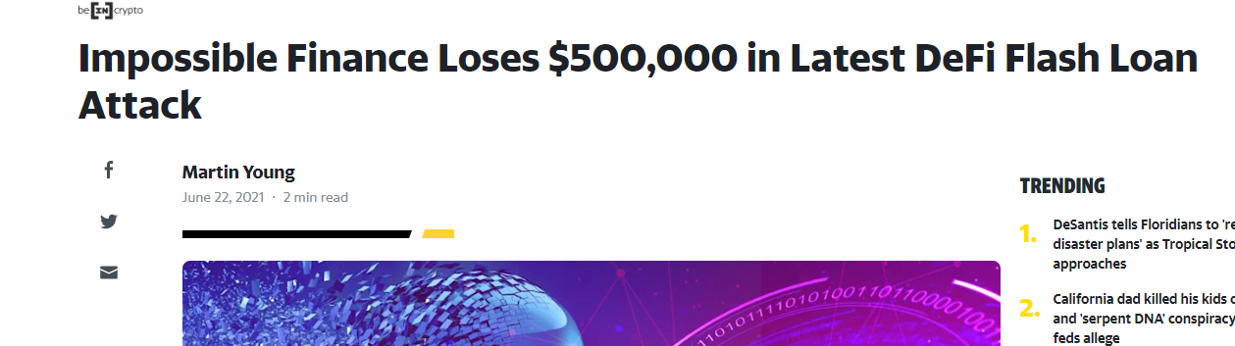

Slide 94
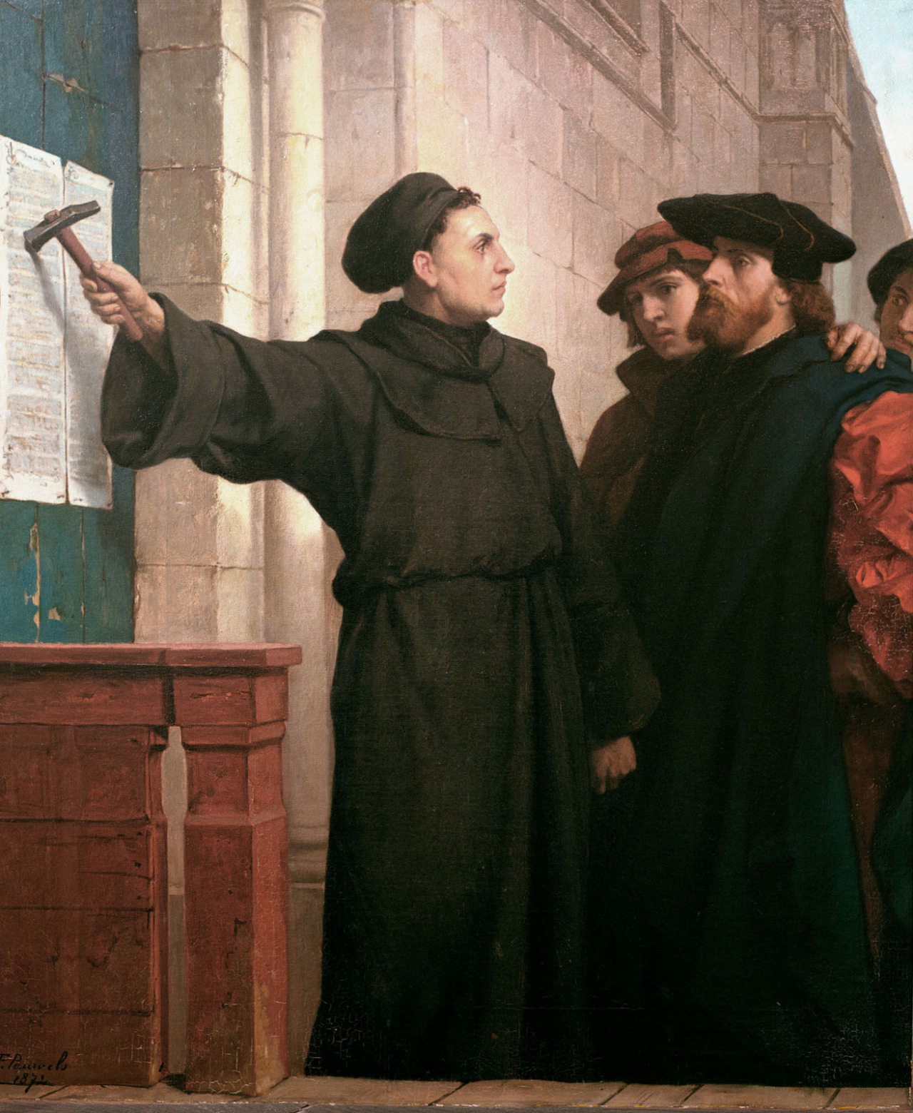
Ideas we covered in this lecture
Exchanges, centralized and decentralized
Order book
AMMs
Constant product
General AMMs
Front-running & Flash loans

